Slide 1
Advanced
Data Visualization
Open source
Ashesh Das
Soumik Sengupta

Slide 2



Agenda
HTML Basics
CSS Basics
JavaScript Basics
Introduction to Open Source Visualization libraries
Overview on Google Charts
Overview on D3.JS
Qlik Sense Mashups
Implementations
FIDELITY INTERNAL INFORMATION
2

Slide 3
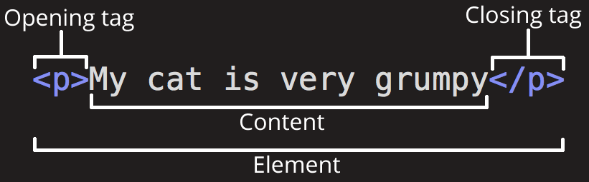
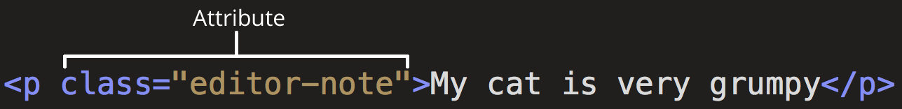
HTML Basics
HTML is not a programming language; it is a markup language that defines the structure of your content.
Elements have attributes which can be defined as follows:
FIDELITY INTERNAL INFORMATION
3

Slide 4
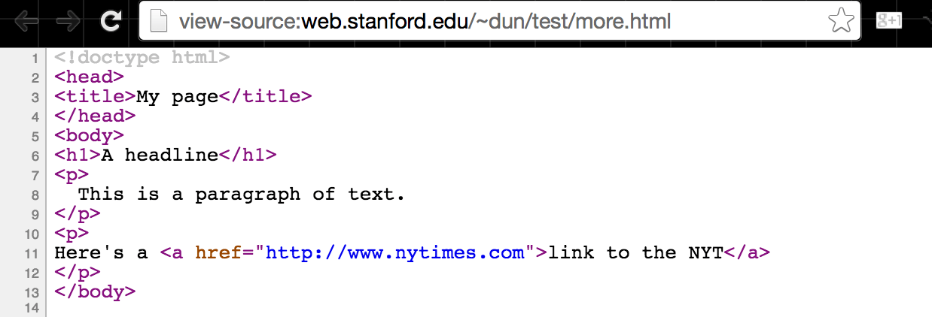
HTML Basics
A simple HTML page:
FIDELITY INTERNAL INFORMATION
4

Slide 5
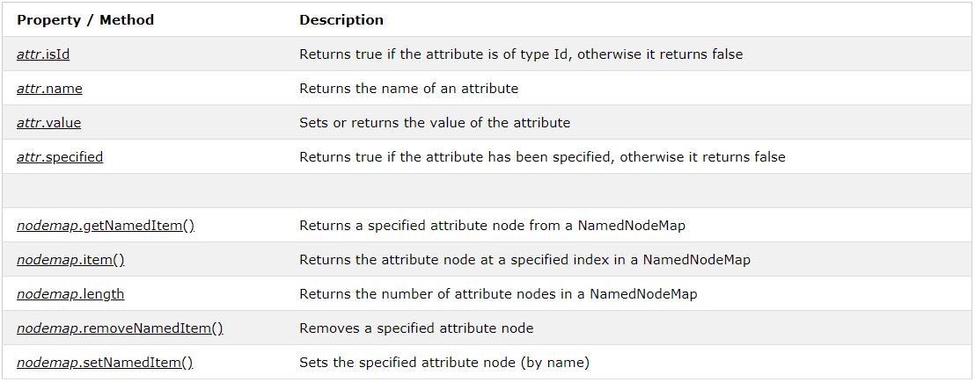
HTML Basics
Introduction to HTML DOM:
In the HTML DOM, the Attr object represents an HTML attribute.
An HTML attribute always belongs to an HTML element.
FIDELITY INTERNAL INFORMATION
5

Slide 6
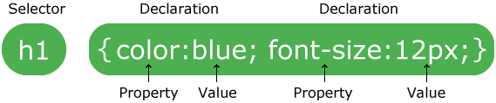
CSS Basics
CSS stands for Cascading Style Sheets
CSS describes how HTML elements are to be displayed on screen, paper, or in other media
CSS saves a lot of work. It can control the layout of multiple web pages all at once
External stylesheets are stored in CSS files
Example:
FIDELITY INTERNAL INFORMATION
6

Slide 7
JavaScript Basics
JavaScript and Java are completely different languages, both in concept and design.
JavaScript can change HTML Content
One of many JavaScript HTML methods is getElementById().
Example
document.getElementById("demo").innerHTML = "Hello JavaScript";
Bulb on/off example
FIDELITY INTERNAL INFORMATION
7

Slide 8
Introduction to Open Source Viz libraries
Google Charts (https://developers.google.com/chart/)
D3 (https://d3js.org/)
ChartJS (https://www.chartjs.org/)
FIDELITY INTERNAL INFORMATION
8

Slide 9
Using D3
Include in header :
<script src="https://d3js.org/d3.v4.min.js"></script> DOM Elements : d3.select() .append() .insert() .attr()
FIDELITY INTERNAL INFORMATION
9

Slide 10
Scalable Vector Graphics
What is SVG?
SVG is an image that is text-based.
SVG is similar in structure to HTML
SVG sits in the DOM
SVG properties can be specified as attributes
SVG should have absolute positions relative to the origin (0, 0)
For more information please go to : https://www.w3.org/TR/SVG/
FIDELITY INTERNAL INFORMATION
10

Slide 11
Scalable Vector Graphics
What is SVG?
SVG is an image that is text-based.
SVG is similar in structure to HTML
SVG sits in the DOM
SVG properties can be specified as attributes
SVG should have absolute positions relative to the origin (0, 0)
For more information please go to : https://www.w3.org/TR/SVG/

Slide 12
Demo: Bar Chart : http://www.tutorialsteacher.com/d3js/animated-bar-chart-d3 Pie Chart : http://www.tutorialsteacher.com/d3js/create-pie-chart-using-d3js

Slide 13
THANK YOU

